Slide 1
PresentAR
A WEB-BASED PRESENTATION SYSTEM WITH INTEGRATED IMU-BASED 3D MODEL CONTROL

Slide 2
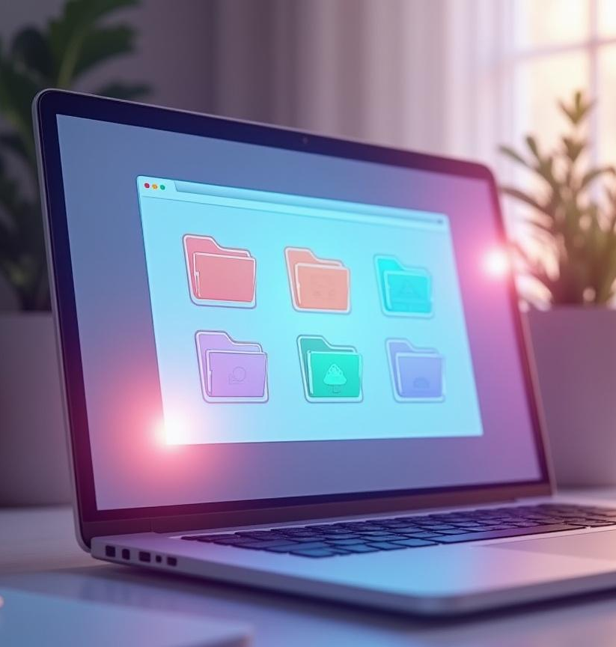
Introduction
This project introduces a web-based presentation tool aimed at overcoming content fragmentation and interaction limitations in traditional presentation systems. It integrates multiple file formats into a single presentation and offers intuitive 3D model control combined with remote recording capabilities, enhancing both delivery and sharing of lessons.

Slide 3

01
System Overview

Slide 4
Problem Identification
Educators face fragmented workflows due to multiple file types like PDFs, PPTX, and 3D models. Traditional hardware limits interaction to linear navigation without 3D control. Additionally, there is no integrated method to record and share the presentation seamlessly, complicating dissemination.

Slide 5
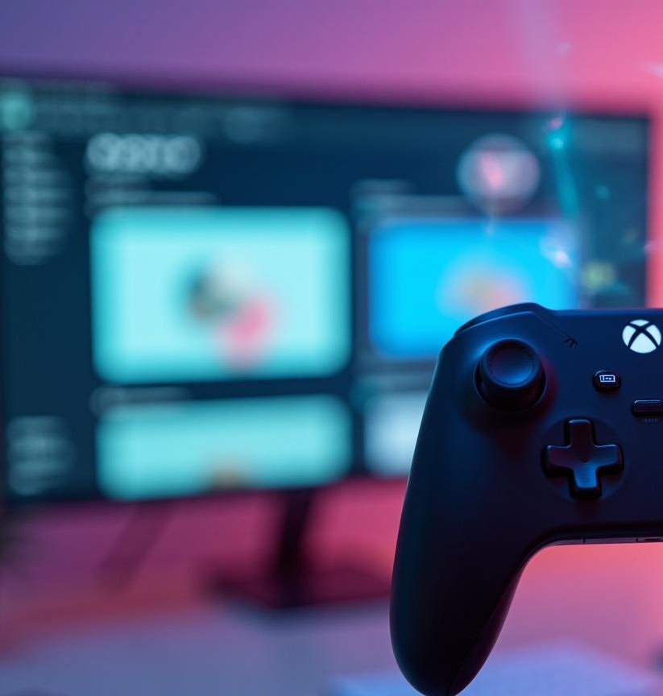
Dual-Component Architecture: Handheld Controller and Web Application
The system combines a custom ESP32-based handheld controller with joystick and IMU sensors for real-time control, and a React-based web app that aggregates files, renders slides and 3D content, and manages recording and conversion processes within a browser environment.

Slide 6
Core Technologies
Utilizing React, Web server API, three.js for 3D rendering, and MediaRecorder API with FFmpeg.wasm, the tool aggregates diverse files into unified slides. The controller sends real-time navigation and motion data via websocket, enabling interactive presentations. Screen and audio recording is triggered remotely and converted to shareable MP4 format efficiently within the browser.

Slide 7

02
Technical Implementation

Slide 8
Hardware Design
The handheld controller is powered by an ESP32s3 processor with Bluetooth Low Energy. It includes a display for touch control and navigation , a 6-axis MPU6500 IMU enabling intuitive 3D model control. The device also incorporates an onboard digital microphone and a dedicated record button to toggle presentation recording remotely.

Slide 9
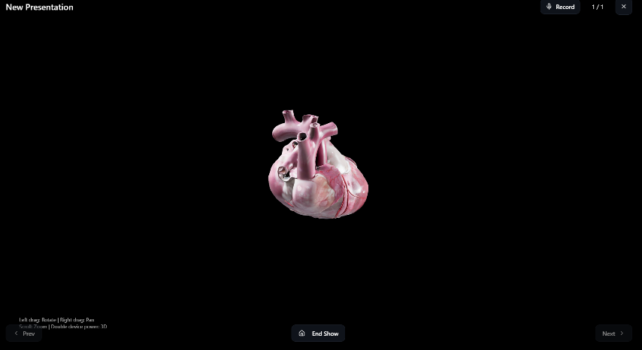
Real-time 3D Rendering
The web app aggregates multiple file types—PDFs, PPTX, DOCX, and 3D models—into a unified slide deck using parsers like PDF.js and officeparser. It maintains real-time communication with the controller over Websocket and renders complex 3D content using three.js, all within a single React-based SPA.

Slide 10
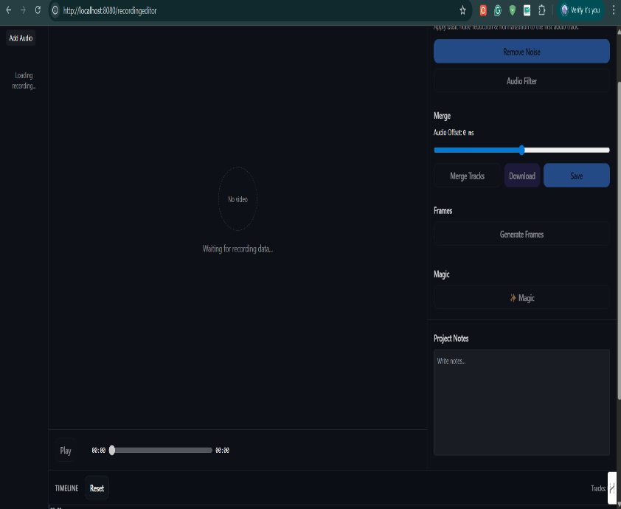
Recording Editor
When the record button is triggered, screen and audio streams are captured simultaneously using browser APIs. The recording is processed asynchronously with MediaRecorder creating a .webm file, then converted in the background by FFmpeg.wasm to a shareable MP4, ensuring smooth user interaction during intensive processing.

Slide 11
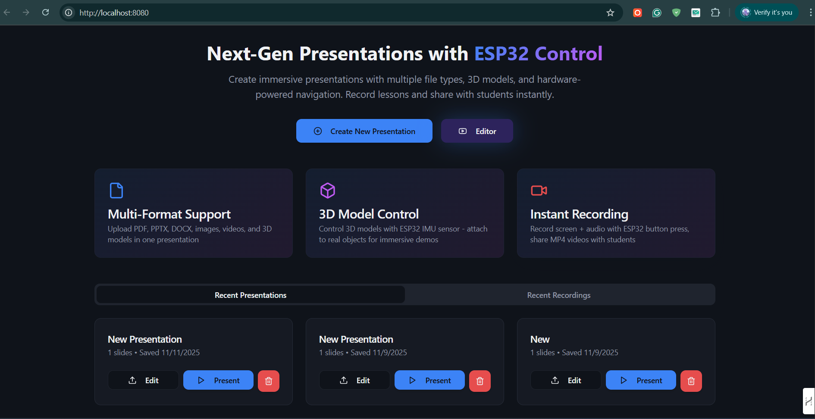

Slide 12
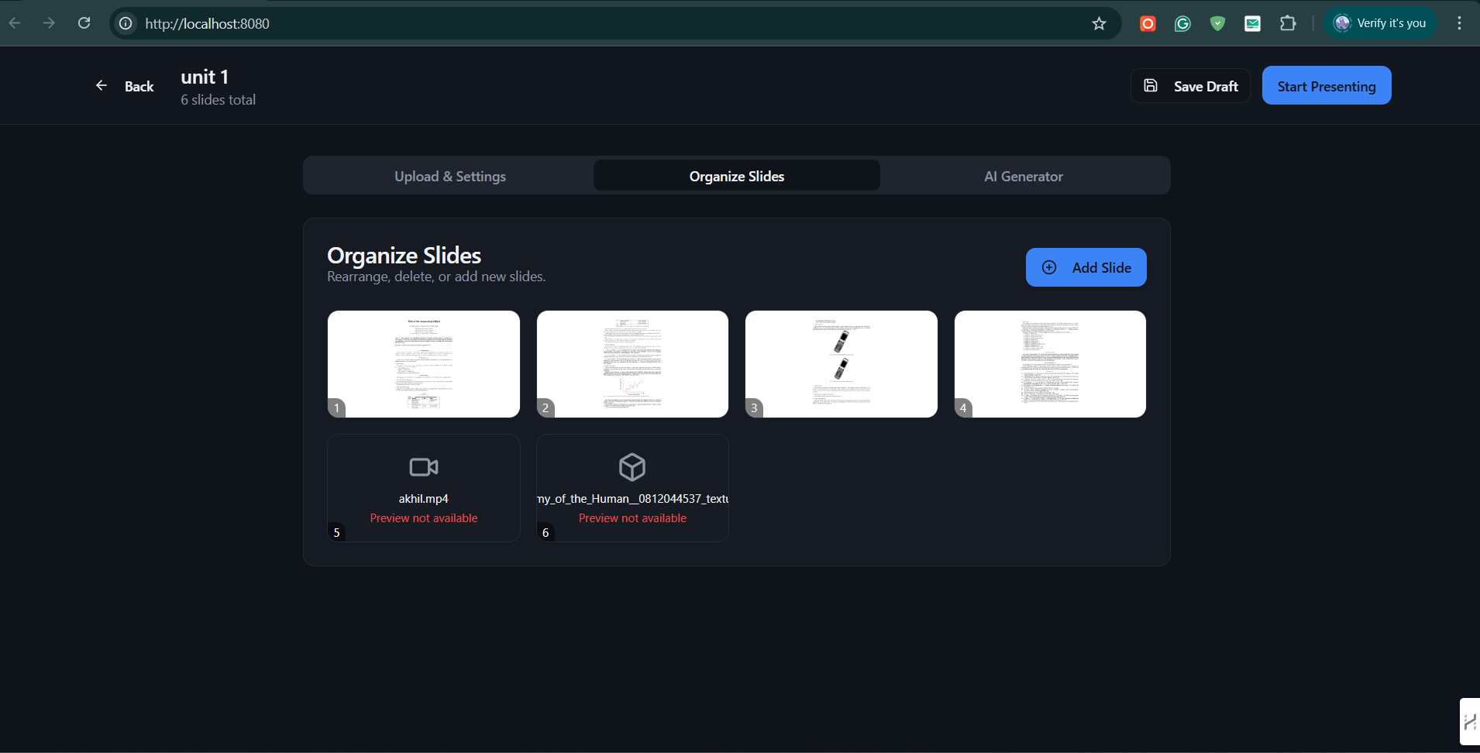

Slide 13
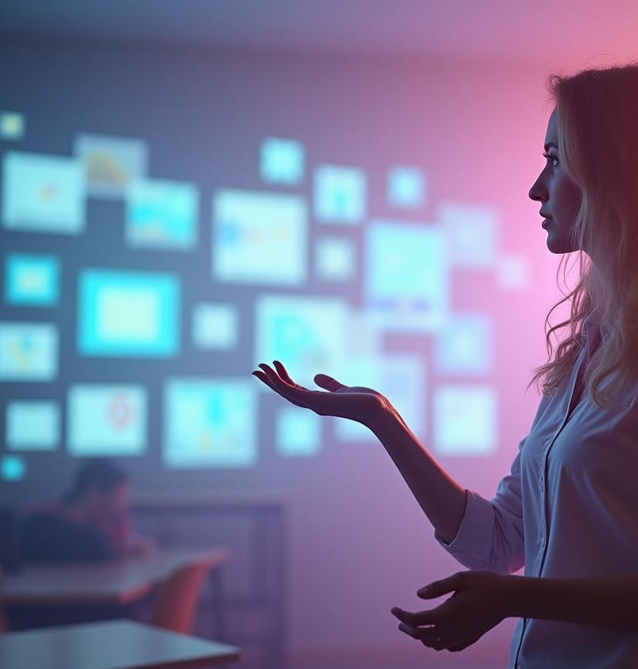
Conclusions
This unified tool effectively addresses content fragmentation, non-intuitive interaction, and dissemination challenges in technical presentations. Its innovative integration of hardware and software components enables educators to deliver rich multimedia lessons with intuitive control and seamless recording, all via a platform-independent web interface, paving the way for enhanced educational workflows.

